Slide 1
Disk I/O Operations
(File Handling)
Notes:
04/29/19
http://nmims.shirpurcampus.googlepage.com

Slide 2
File handling
When a large amount of data is to be handled, external devices such as hard disks are required to store the data .
The data is stored in these devices using the concept of files.
A file is a collection of related data stored in a particular area on a disk.
A program typically may involve following kinds of data communication:
1. Data transfer b/w the console unit and the program.
2. Data transfer b/w the program and disk files.
04/29/19
Notes:
04/29/19
http://nmims.shirpurcampus.googlepage.com

Slide 3
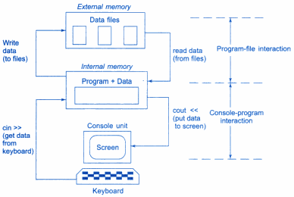
File handling
04/29/19
Notes:
04/29/19
http://nmims.shirpurcampus.googlepage.com

Slide 4
File handling
Programs can be designed to perform the read and write operations on the disk files.
The I/O system of C++ handles file operations which are very much similar to the console input and output operations.
It uses file streams as an interface between the programs and files.
The stream that supplies data to the program is called input stream and the one that receives data from the program is called output stream.
In other words input stream extracts(reads) data from the file and output stream inserts(writes) data to the file.
04/29/19
Notes:
04/29/19
http://nmims.shirpurcampus.googlepage.com

Slide 5
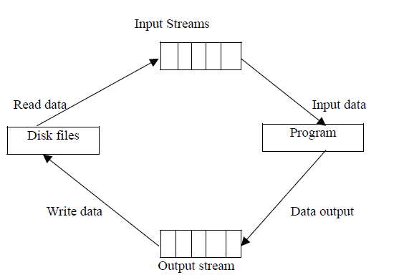
File input and output streams
The input operation involves the creation of an input stream and linking it with the program and input file.
Similarly, the output operation involves establishing an output stream with the necessary links with the program and output file.
04/29/19
Notes:
04/29/19
http://nmims.shirpurcampus.googlepage.com

Slide 6
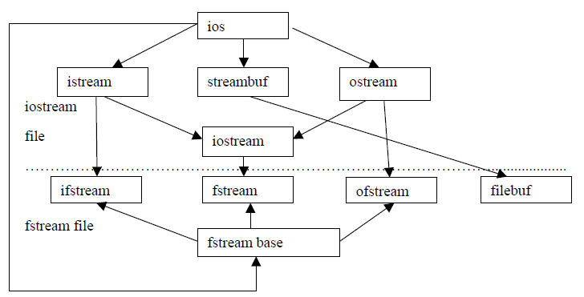
Stream classes for file operations
04/29/19
Notes:
04/29/19
http://nmims.shirpurcampus.googlepage.com

Slide 7
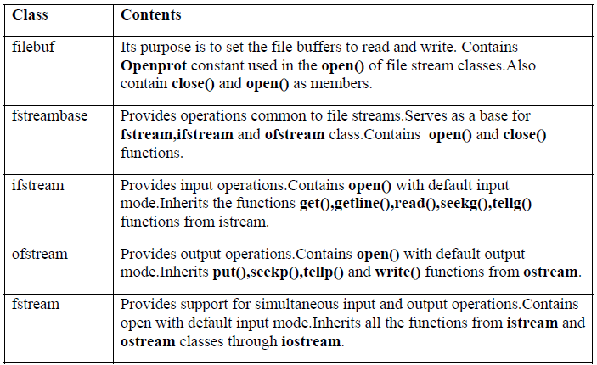
Stream classes for file operations
04/29/19
Notes:
04/29/19
http://nmims.shirpurcampus.googlepage.com

Slide 8
Opening a file
A file can be opened in two ways:
  Using constructor function of the class.
  Using the member function of the class.
First method is used when we use only one file in the stream.
Second method is used when we want to manage multiple files using one stream.
04/29/19
Notes:
04/29/19
http://nmims.shirpurcampus.googlepage.com

Slide 9
Opening file using constructors
Constructors as discussed is used to initialize an object while it is being created.
Here file name is used to initialize the file stream object.
This involves the following steps:
  Create file stream object to manage the stream using the appropriate class.
    ofstream is used to create output stream and
    ifstream to create the input stream.
  Initialize the file object with the desired filename.
    Eg: ofstream outfile(“results.txt”); //output only
    ifstream infile(“data.txt”); //input only
04/29/19
04/29/19
Notes:
04/29/19
http://nmims.shirpurcampus.googlepage.com
http://nmims.shirpurcampus.googlepage.com

Slide 10
Opening file using constructors(cont…)
ofstream outfile(“results.txt”); create outfile as an ofstream object that manages the output stream.
Similarly , ifstream infile (“data.txt”);statement declares infile as an ifstream object and attaches it to the file data for reading (input).
The same file name can be used for both reading and writing data
Example:
ofstream outfile (“salary”); //creates outfile and connects salary to it
outfile<<“72000 Rs ”;
outfile.close(); //disconnect salary from outfile and connect to infile
ifstream infile (“salary”);
infile>>str;
infile.close();
04/29/19
Notes:
04/29/19
http://nmims.shirpurcampus.googlepage.com

Slide 11
Working with single file
#include <iostream>
#include <fstream>
using namespace std;
int main() {
  char line[100],line1[100];
  ofstream outf("myfile.txt"); // if file does not exist it will be created
  cout<<"good bit="<<outf.good()<<endl;
  if(outf.good()) // good() function returns 1 if everything is ok
  cout<<"Everything is OK\n File is opened :\n";
  else{
  cout<<"Error:!\n";
  return 0;
  }
  cout <<"enter some text: ";
  cin.getline(line,100);
  outf <<line<<"\n"; // writing line in file attached with outf
  outf.close(); // // disconnect file from outf object and close it
  getch(); // just to halt
04/29/19
Notes:
04/29/19
http://nmims.shirpurcampus.googlepage.com

Slide 12
Working with single file (contd…)
  ifstream inf("myfile.txt"); // open file to read data
  cout<<"good bit="<<inf.good()<<endl;
  if(inf.good()) // good() function returns 1 if everything is ok
  cout<<"Everything is OK\n File is opened :\n";
  else{
  cout<<"Error: File does not exist!\n";
  return 0;
  }
  inf.getline(line1,1000); // read text from file and store in line1 char array
  cout <<"text is : " << line1 <<"\n";
  inf.close(); // disconnect file from inf object and close it
  getch();
  return 0;
  }
Note: ‘outf’ object of class ofstream will open an existing file. If the file doesn’t exist, it is created. If it exist, it is truncated and the new data replaces the old.
04/29/19
Notes:
04/29/19
http://nmims.shirpurcampus.googlepage.com

Slide 13
Opening file Using the member function
The function open() can be used to open multiple files that uses the same stream object sequentially.
Create single stream object and use to open each file.
Example:
File-stream-class stream_object_name;
Stream_object_name.open (“filename”);
  ofstream fout; //object created
  fout.open(“country”); //country file is created if not exist
04/29/19
Notes:
04/29/19
http://nmims.shirpurcampus.googlepage.com

Slide 14
Problem
Create output file object fout
Open file name country using fout
Write “United states of America” ,”United Kingdom”; and ”South korea” in 3 separate lines.
Close the file country
Open another file capital and write ”Washington”, ”London” and ”Seoul” in 3 separate lines
Close file capital
Open both files in read mode and display the contents on console
04/29/19
Notes:
04/29/19
http://nmims.shirpurcampus.googlepage.com

Slide 15
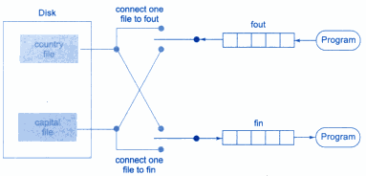
Working with multiple files
04/29/19
Notes:
04/29/19
http://nmims.shirpurcampus.googlepage.com

Slide 16
Working with multiple files
#include <iostream >
#include<fstream>
using namespace std;
int main(){
  ofstream fout; //object created
  fout.open("country.txt"); //1st file
  fout<<"United states of America \n";
  fout<<"United Kingdom\n";
  fout<<"South korea\n";
  fout.close();
  fout.open("capital.txt"); //2nd file
  fout<<"Washington\n";
  fout<<"London\n";
  fout<<"Seoul \n";
  fout.close();
  const int N =80;
  char line[N];
  ifstream fin;
  fin.open("country_capital.cpp");
  cout<<"contents of country file \n";
  while (fin)
  {
  fin.getline(line,N);
  cout<<line<<endl;
  }
  fin.close();
  fin.open("capital.txt");
  cout<<"contents of capital file\n";
  while(fin)
  {
  fin.getline(line,N);
  cout<<line<<endl;
  }
  fin.close();
  return 0;
}
04/29/19
Notes:
04/29/19
http://nmims.shirpurcampus.googlepage.com

Slide 17
Finding End of File
While reading a data from a file, it is necessary to find where the file ends i.e end of file, otherwise program may go in an infinite loop.
An ifstream object such as ‘fin’ returns a value of 0 if any error occurs in the file operation including the end-of –file condition.
Thus the while loop terminates when ‘fin’ returns a value of zero on reaching the end-of-file condition.
Following statement can also detect the end of file condition.
if(fin1.eof() !=0 ) //eof() returns non-zero if end-of-file encounter
{
exit(1);
}
04/29/19
Notes:
04/29/19
http://nmims.shirpurcampus.googlepage.com

Slide 18
Reading from two Files simultaneously
#include <iostream >
#include<fstream>
int main()
{
  const int N =80;
  char line1[N],line2[N];
  ifstream fin1,fin2;
  fin1.open("country.txt");
  fin2.open("capital.txt");
  cout<<"contents are: \n";
  int i=0;
  while (1)
  {
  if(fin1.getline(line1,N)==0 || fin2.getline(line2,N)==0)
  break;
  cout<<line1<<" "<<line2<<endl;
  }
  fin1.close();
  fin2.close();
  return 0;
}
04/29/19
Notes:
04/29/19
http://nmims.shirpurcampus.googlepage.com

Slide 19
File Opening Modes
The ifstream and ofstream constructors and the function open() are used to open the files.
Up to now a single arguments is used that is filename. However, these functions can take two arguments, the second one for specifying the file mode.
The general form of function open() with two arguments is:
stream-object.open(“filename”,mode);
first argument specifies the name and location of the file to be opened and the second argument defines the mode in which the file should be opened.
04/29/19
Notes:
04/29/19
http://nmims.shirpurcampus.googlepage.com

Slide 20
File Opening Modes
mode | Stand for | Description
ios::in | input | File open for reading: the internal stream buffer supports input operations.
ios::out | output | File open for writing: the internal stream buffer supports output operations.
ios::ate | at end | The output position starts at the end of the file. Edit is possible.
ios::app | append | All output operations happen at the end of the file, appending to its existing contents.
ios::trunc | truncate | Any content that existed in the file before it is open are discarded.
ios::binary | binary | Operations are performed in binary mode rather than text.
04/29/19
Notes:
04/29/19
http://nmims.shirpurcampus.googlepage.com

Slide 21
File Opening Modes
We can combine two or more file opening modes with the help of | (OR) operator them together as:
ofstream outfile; outfile.open("file.txt", ios::out | ios::trunc );
This can be used to open a file in write mode and to delete the text if already exists.
Similar way, you can open a file for reading and writing purpose as follows:
fstream afile;
afile.open("file.txt", ios::out | ios::in );
Default Open Modes :
ifstream | ios::in
ofstream | ios::out | ios::trunc
fstream | ios::in | ios::out
04/29/19
Notes:
04/29/19
http://nmims.shirpurcampus.googlepage.com

Slide 22
Important points
Opening a file in ios::out mode also opens in the ios::trunc mode by default.
Both ios :: app and ios :: ate take us to the end of the file when it is opened. The difference between the two parameters is that the ios :: app allows us to add data to the end of file only; whereas ios :: ate mode permits us to add data or to modify the existing data any where in the file.
fstream object can open a file in read and write mode however it will fail if file doesn’t exist.
For example: fstream fp(“my_file.txt”); can not work if file doesn’t exit. Following two statements will work:
fstream pf(“my_file.txt”, ios::app);
fstream pf(“my_file.txt”, ios::in |ios::out|ios::trunc);
04/29/19
Notes:
04/29/19
http://nmims.shirpurcampus.googlepage.com

Slide 23
File Pointers and Manipulators
Each file has two pointers known as file pointers: input pointer and output pointer.
Input pointer is used for reading the contents of a given file location
Output pointer is used for writing to a given file location.
Each time an input or output operation takes place , the appropriate pointer is automatically gets updated.
When a file is opened in read-only mode (ios::in) , the input pointer is automatically set at the beginning so that file can be read from the start.
Similarly when a file is opened in write-only (ios::out) mode the existing contents are deleted and the output pointer is set at the beginning. This enables us to write the file from start.
In case an existing file is to be opened in order to add more data, the file is opened in append mode (ios::app). This moves the pointer to the end of file.
04/29/19
Notes:
04/29/19
http://nmims.shirpurcampus.googlepage.com

Slide 24
Functions for Manipulating the File pointers
For controlling the movement of file pointers, file stream classes provide the following functions :
1. seekg() Moves get pointer (input)to a specified location.
2. seekp() Moves put pointer (output) to a specified location.
3. tellg() Gives the current position of the get pointer.
4. tellp() Gives the current position of the put pointer.
04/29/19
Notes:
04/29/19
http://nmims.shirpurcampus.googlepage.com

Slide 25
Functions for Manipulating the File pointer
For example, the statement
infile.seekg(10); will move the pointer to the 10th index.
Note: That the bytes in a file are numbered beginning from zero. Therefore ,the get pointer will point to the 11th byte in the file.
Consider the following statements:
ofstream fileout;
fileout.open(“hello.txt”,ios::app);
int p=fileout.tellp();
On execution of these statements, the output pointer is moved to the end of file “hello.txt”
And the value of p will represent the number of bytes in the file.
04/29/19
Notes:
04/29/19
http://nmims.shirpurcampus.googlepage.com

Slide 26
Specifying the Offset
seekg() and seekp() functions can also be used with two arguments as follows:
seekg (offset,refposition); //move get pointer
seekp (offset,refposition); //move put pointer
The parameter offset represents the number of bytes the file pointer is to be moved from the location specified by the parameter refposition.
The refposition takes one of the following three constants defined in the ios class:
ios::beg //Start of file
ios::cur //Current position of the pointer
ios::end //End of file
04/29/19
Notes:
04/29/19
http://nmims.shirpurcampus.googlepage.com

Slide 27
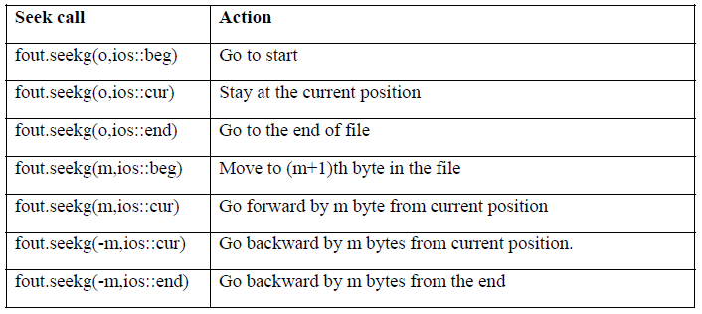
Specifying the Offset
04/29/19
Notes:
04/29/19
http://nmims.shirpurcampus.googlepage.com

Slide 28
Exercises
Q1 Write statements using seekg() to achieve the following:
(a) To move the pointer by 15 positions backward from current position.
(b) To go to the beginning after an operation is over.
(c) To go backward by 20 bytes from the end.
(d) To go to 50th byte in the file.
Q2 Write C++ program to write multiple lines using keyboard. Stop when user enters “-1”. Display the content of text file on the terminal.
04/29/19
Notes:
04/29/19
http://nmims.shirpurcampus.googlepage.com

Slide 29
Q2 Solution
int main(){
fstream fio;
string line;
fio.open("sample1.txt", ios::trunc | ios::out | ios::in);
cout<<"Enter text\n";
while (fio) {
getline(cin, line);
if (line == "-1")
break;
fio << line << endl; // Write line in file
cout<<"Enter text or enter -1 to stop\n";
}
cout<<"position of get pointer ="<<fio.tellg()<<endl;
cout<<"position of put pointer ="<<fio.tellp()<<endl;
fio.seekg(0, ios::beg);
while (fio) {
getline(fio, line); // Read a Line from File
cout << line << endl; // Print line in Console
}
fio.close(); // Close the file
getch();
return 0;
}
04/29/19
Notes:
04/29/19
http://nmims.shirpurcampus.googlepage.com

Slide 30
Predict the Output
#include <iostream> #include <fstream> #include<conio.h> using namespace std; int main() { ofstream outf("myfile66.txt"); // if file is not exist it will be created outf <<"Hello JUET BZ batch !"; outf.seekp(6); // set output file pointer to 7th byte outf <<"Guna MP"; outf.close(); getch(); // just to halt return 0; }
Hello Guna MP batch !
04/29/19
Notes:
04/29/19
http://nmims.shirpurcampus.googlepage.com

Slide 31
Input and Output Operations on files
put() and get() are designed for handling a single character at a time.
write(),read() are designed to write and read blocks of binary data.
put()- writes a single character to the associated stream.
get() - reads a single character from the associated stream.
04/29/19
Notes:
04/29/19
http://nmims.shirpurcampus.googlepage.com

Slide 32
Using put() and get() Functions
#include<iostream>
#include<fstream>
#include<string.h>
using namespace std;
int main(){
char string[50];
cout<<"Enter a String:";
cin.getline(string,50);
int len=strlen(string);
fstream file;
file.open("Myfile.txt", ios::in| ios::out);
for(int i=0;i<len;i++)
file.put(string[i]); // writing character wise into a file
file.seekg(0); // go to the start of the file
char ch;
while(file.get(ch)) // detecting end of file
{
cout<<ch;
}
return 0;
} .
O/p
Enter a string :programming // input
programming // output
04/29/19
Notes:
04/29/19
http://nmims.shirpurcampus.googlepage.com

Slide 33
write() and read() functions
Handle the data in binary form.
The values are stored in the disk file in the same format in which they are stored in the internal memory.
The binary format is more accurate for storing the numbers as they are stored in the exact internal representation.
There is no conversions while saving the data and therefore saving is faster.
Binary vs character formats: Example:
Integer value 2594 is represented as follows:
binary format ( 2 bytes): 00001010 00100010
character format(4 bytes): 2 5 9 4
04/29/19
Notes:
04/29/19
http://nmims.shirpurcampus.googlepage.com

Slide 34
write() and read() functions
Syntax:
infile.read((char*)& V,sizeof(V));
outfile.write((char*)& V,sizeof(V));
First argument is the address of the variable V
Second argument is the length of that variable in bytes.
04/29/19
Notes:
04/29/19
http://nmims.shirpurcampus.googlepage.com

Slide 35
write() and read() functions:example
#include<iostream>
#include<fstream>
#include<iomanip>
#include<conio.h>
using namespace std;
int main(){
float height[4]={17.2, 12.2, 13.2, 11.2};
ofstream outfile;
outfile.open("BINARY.dat", ios::binary);
outfile.write((char*) height, sizeof(height));
outfile.close();
for(int i=0;i<4;i++)
height[i]=0;
ifstream infile;
infile.open("BINARY.dat", ios::binary);
infile.read((char *)height, sizeof(height));
for(int i=0;i<4;i++)
{
cout<<setw(10)<<std::fixed<<setprecision(2)<<height[i];
}
infile.close();
return 0;
}
Output:
17.20 12.20 13.20 11.20
04/29/19
Notes:
04/29/19
http://nmims.shirpurcampus.googlepage.com

Slide 36
Reading and writing a class object
Since the class objects are the central elements of C++ programming, it is quite natural that the language supports features for reading and writing from the disk files objects directly.
Binary input and output functions read() and write() are designed to do this job.
These functions handle the entire structure of an object as a single unit.
Only data members are written on the disk file and not the member functions
04/29/19
04/29/19
Notes:
04/29/19
http://nmims.shirpurcampus.googlepage.com
http://nmims.shirpurcampus.googlepage.com

Slide 37
Reading and writing a class object : example
#include <iostream >
#include <fstream>
#include<conio.h>
using namespace std;
class student
{
char name[30];
int rollno;
float fees;
public:
void getdata( )
{
cout<<"\nEnter rollno, name, fees:";
cin>>rollno >>name >>fees;
}
void putdata()
{
cout<<rollno<<"\t";
cout<<name<<"\t"<<fees<<"\n";
}
};
int main()
{
student stud[5];
fstream fp;
fp.open("record.dat", ios :: in | ios :: out | ios::binary | ios::app);
cout<<"Enter Student Data";
for (int i=0;i<5;i++) //writing data on file
{
stud[i]. getdata();
fp.write((char*)&stud[i],sizeof(stud[i]));
}
fp.seekg(0);
cout<<"The student Data\n";
for(int i=0; i< 5; i++) //reading data from file.
{
fp.read((char *)&stud[i],sizeof(stud[i]));
stud[i].putdata();
}
fp.close();
getch();
return 0;
}
04/29/19
04/29/19
Notes:
04/29/19
http://nmims.shirpurcampus.googlepage.com
http://nmims.shirpurcampus.googlepage.com

Slide 38
Reading the content of given object : example
int main()
{
  student stud;
  Int n;
  fstream infile;
  infile.open("record.dat",ios::in | ios::out | ios::binary);// assuming record.dat file existed
  infile.seekg(0);
  infile.seekg(0, ios::end); // go to end
  int endposition = infile.tellg(); // find where we are
  int total_objects = endposition/sizeof(stud); // number of students
  cout <<"\n There are " << total_objects << " students in file: ";
  cout << "\n Enter student number: ";
  cin >> n;
  int position=n*sizeof(stud);//number times size
  infile.seekg(position);
  infile.read((char*)&stud,sizeof(stud));
  stud.putdata(); // display the person
  infile.close();
  getch();
  return 0;
}
04/29/19
Notes:
04/29/19
http://nmims.shirpurcampus.googlepage.com

Slide 39
Error Handling during File Operations
There can be many problems that may encounter while dealing with files like
    • A file which we are attempting to open for reading does not exist.
    • The file name used for a new file may already exist.
    • We are attempting an invalid operation such as reading past the end of file.
    • There may not be any space in the disk for storing more data.
    • We may use invalid file name.
    • We may attempt to perform an operation when the file is not opened for that purpose.
The class ios support several member functions that can be used to read the status recorded in a file stream.
04/29/19
Notes:
04/29/19
http://nmims.shirpurcampus.googlepage.com

Slide 40
Error Handling Functions
 | NAME | PURPOSE
1 | eof() | Returns true if eof file is reached
2 | fail() | Returns true if fail bit, bad bit is set (Logical error on i/o operation, like trying o read int in place of string)
3 | bad() | Returns true if bad bit is set (Read/writing error on i/o operation)
4 | good() | Returns true, if everything is ok
5 | clear() | Clears all the bits to zero
6 | clear(bit name) | Clears specific bit to zero
04/29/19
Notes:
04/29/19
http://nmims.shirpurcampus.googlepage.com

Slide 41
Error Handling during File Operations
These functions can be used at the appropriate places in a program to locate the status of a file stream and thereby to take the necessary corrective measures. Example:
……………
ifstream infile;
infile.open(“ABC”);
while(!infile.fail())
{
………….. (process the file)
}
if (infile.eof())
{
……………(terminate the program normally)
}
else if (infile.bad())
{
…………….(report fatal error)
}
else
{
infile.clear(); //clear error state clear() resets the error state so that further operations can be attempted.
……….
}
04/29/19
Notes:
04/29/19
http://nmims.shirpurcampus.googlepage.com

Slide 42
Exercise
Write a program in C++ to read the file and store the lines into a 2D array of characters.
Write a program in C++ to copy a file in another name.
Write a program in C++ to merge two files and write it in a new file.
Write a program in C++ to encrypt a text file.
04/29/19
Notes:
04/29/19
http://nmims.shirpurcampus.googlepage.com

